Slide 1
Long and Short

Slide 2
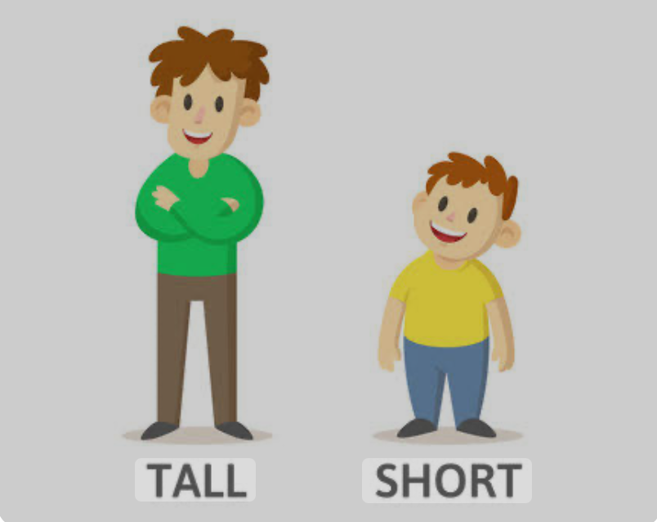

Slide 3
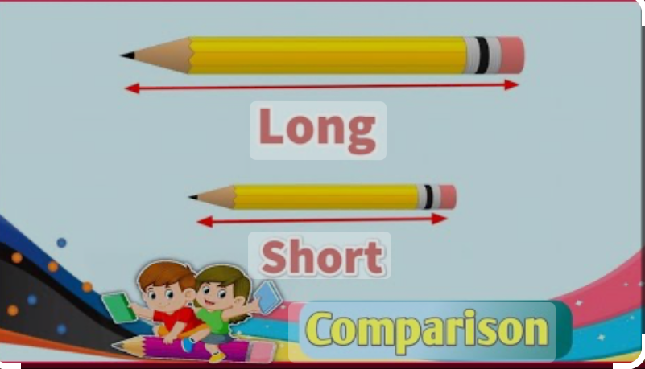

Slide 4
Keywords
1. long
2.short
3.tall
4.longer
5.shorter
6.taller
7.longest
8.tallest
9.shortest

Slide 5
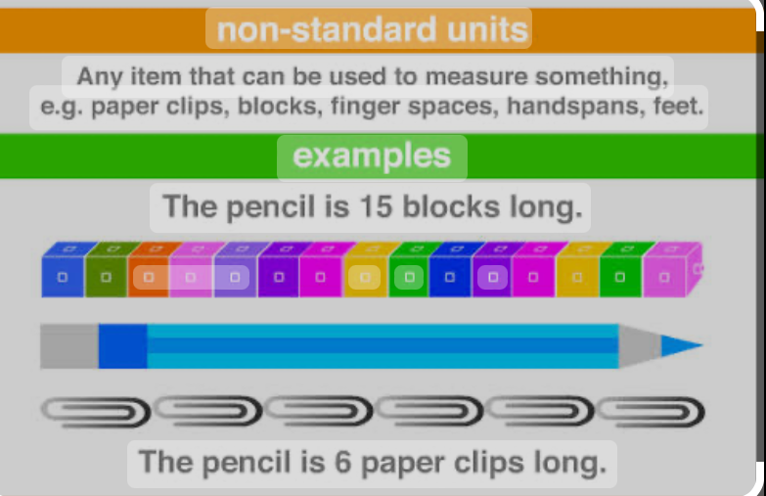

Slide 6
